Slide 1
Introduction to Wireshark
Shaoquan Jiang
University of Windsor

Slide 2
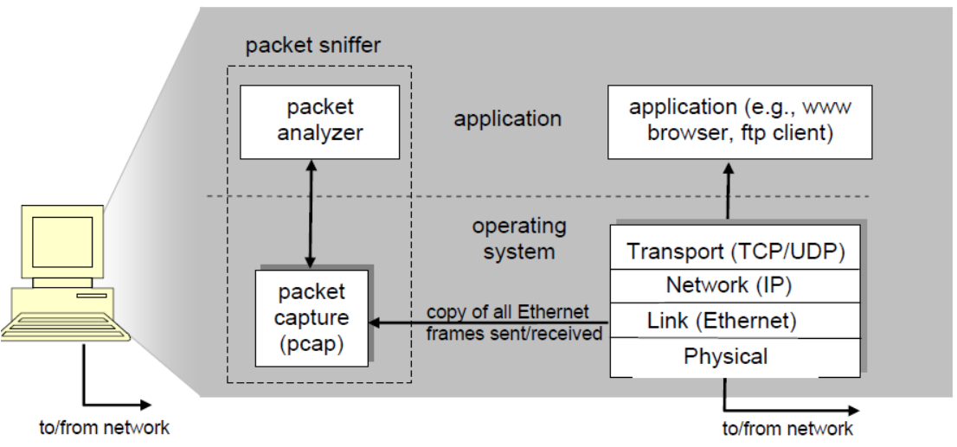
Introduction
The basic tool for observing the messages exchanged between executing protocol entities is called a packet sniffer.
The packet sniffer consists of 2 parts:
The packet capture library receives a copy of every link layer frame that is sent from or received by your computer.
The packet analyzer which displays the contents of all fields within a protocol message.

Slide 3
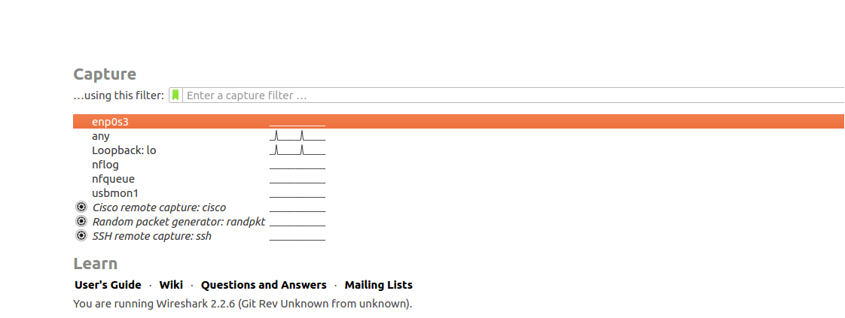
Start Wireshark
After starting Wireshark, you will see the following figure.
enp0s3 is the network interface of our VM connecting to the outside of VM. Double clicking on this interface will start the sniffer on traffic through this interface.
Double click this interface

Slide 4
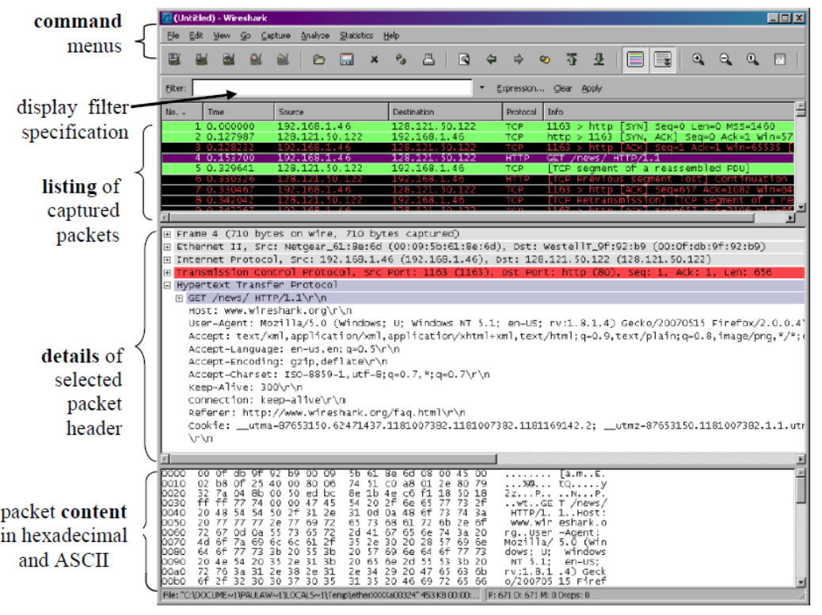
Wireshark Window
Start firefox with a site (e.g., www.uwindsor.ca) and look wireshark window

Slide 5
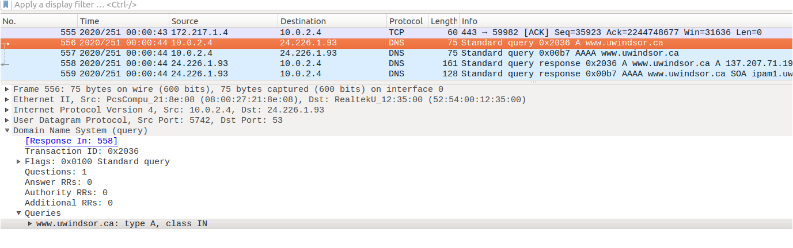
Specific packet
Detailed packet example: DNS query packet.
The structured as LinkLayerHeader||NetworkLayer Header||TransportLayer Header||DNS query
packet
details
Link layer Header
Network Layer Header
Transport Layer Header

Slide 6
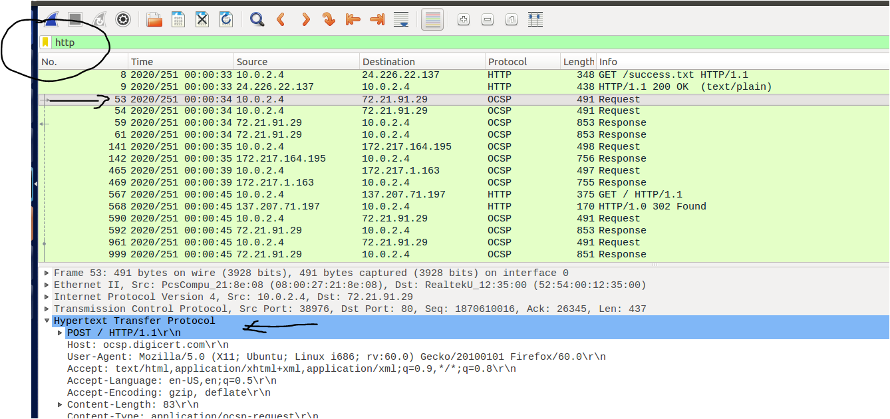
Packet Filter
We can apply a display filter to show restricted packets.
Example: using http filter will only show the packets containing http protocol

